Slide 1
Metro Path Routing System
Group members -
M.P.K.G De Silva 2013CS022
P.D.J.S Jayaratna 2013CS048
M.G.M Madhushanka 2013CS067

Slide 2
problem
Design and implementing a route planning software for the given map (Prague Metro system) to find the quickest journey time for use by the general public.

Slide 3
model & assumptions
We implemented all the paths and stations using graph data structure and consider time as the weight of each edge and then by using famous “Dijkstra’s algorithm” we calculated quickest path and display it with details
Assumptions
A Train is available at any time from one station to another
Only one train is travelling at time.

Slide 4
choice of data structures
Weighted Graph data structure
We use weighted graph data structure because
By using that we can directly use Dijkstra’s algorithm for calculations and also can manage efficiency of the program

Slide 5
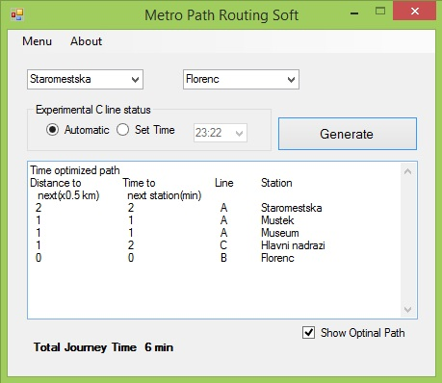
screenshots
Choose Start Station
Choose End Station
Set Time Manually

Slide 6
remarks & reflections
we had to go through lots of examples in order to learn how to use Dijkstra’s algorithm in our program.
And also we had to put extra effort to solve the case when time is changing in middle of the journey .
At last in order to make a GUI we had to get enough knowledge about windows API in visual studio.

